Slide 1
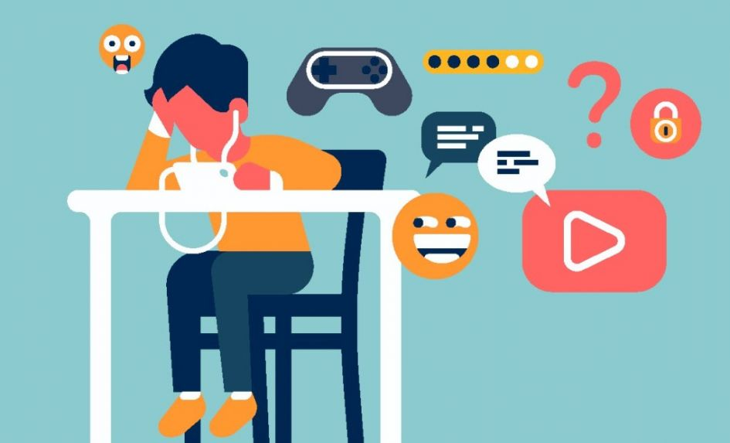
Safety Using ICT
Mr Butler | Unit 2

Slide 2
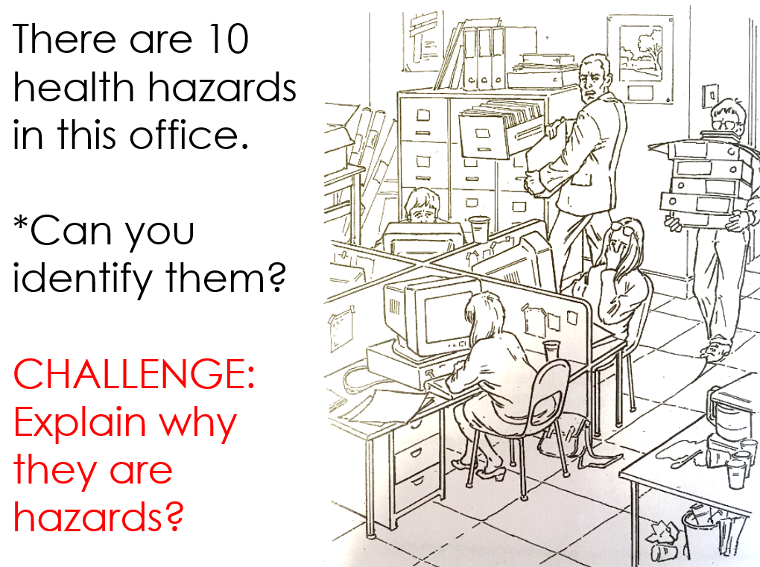

Slide 3

Learning Objectives
Know the importance of health and safety when using technology
Appreciate how common sense can help protect our workplace
Learn some rules about how to keep data safe
Appreciate the importance of protecting our data, and ourselves when using ICT

Slide 4

Working Safely
When using computers, we need to keep certain things safe:
  The equipment
  Our data
  Ourselves
We need to follow Health and Safety rules to keep ourselves safe from any harm.
Most of the rules are common sense – we just need to behave sensibly.
If something looks dangerous, report it to the person in charge.

Slide 5
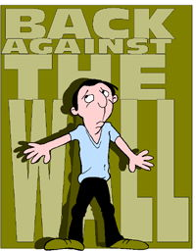
Back Against the Wall
Failing to stick to health and safety rules can result in injury

Slide 6
Back Against the Wall
Backache can be caused by sitting for long periods of time in the same position and having your chair and the wrong height. There is also the possibility of damage to the spine being caused if this is not addressed.

Slide 7
Back Against the Wall
To Combat this potential threat:
  Use an adjustable chair
  Take regular breaks
  Use a footrest
  Change your sitting position (don’t slouch)

Slide 8
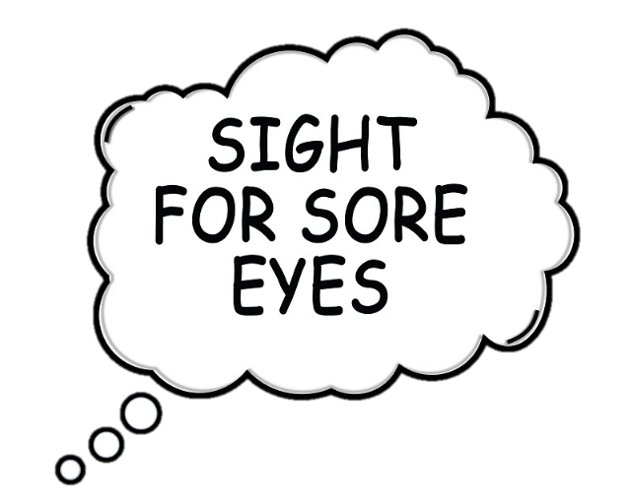
A Sight for Sore Eyes
Eye strain is caused by continuously looking at a screen for an extended period of time. Reflection and glare from bright lights can make it worse.
Constantly straining your eyes can result in headaches, sore eyes and a worsening of your eyesight.

Slide 9
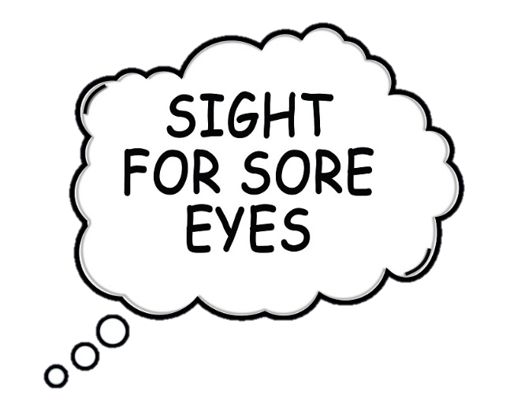
A Sight for Sore Eyes
To combat this potential threat:
  Use suitable screen size
  Take regular breaks
  Fit blinds to windows
  Position your monitor away from direct sunlight
  Use an anti-glare screen

Slide 10

Day After Day After Day
Repetitive Strain Injury (RSI) happens when you constantly make the same movement again and again. It usually affects joints in wrists and fingers.
  Ever played a game for a long time and got sore/numb thumbs? This is has been termed Nintendo thumb.
It can cause extreme pain and damage to the joints – in extreme cases resulting in arthritis.

Slide 11
Day After Day After Day
Combating this potential threat to your health, we can:
  Adjust your keyboard to a comfortable angle.
  Use a wrist rest
  Keep wrists straight when typing
  Take regular breaks

Slide 12


Hazard
What is a Hazard?
Discuss this with the person next to you to come up with a definition.

Slide 13

Definition: Hazard
A danger or risk which is any source of potential damage, harm or adverse health effects on something or someone.

Slide 14
What is Ergonomics?
The science concerned with designing safe and comfortable hardware and office furniture for humans
Ergonomics is designing equipment suitable for humans – for example:
  PlayStation has officially altered its PS4 controller 3 times, although there are hundreds more on the market!
  Microsoft spent “hundreds of millions” designing its xBox One controller

Slide 15

Homework: Due Next Lesson
Ensure you write your homework into your planner.
List 5 hazards and possible ways to combat these hazards in the ICT classroom.
Place this into a Microsoft Word document and upload this before next lesson.

Slide 16

Worksheet: Ergonomics
Using what you have learnt today, complete the ‘Ergonomics’ worksheet.

Slide 17
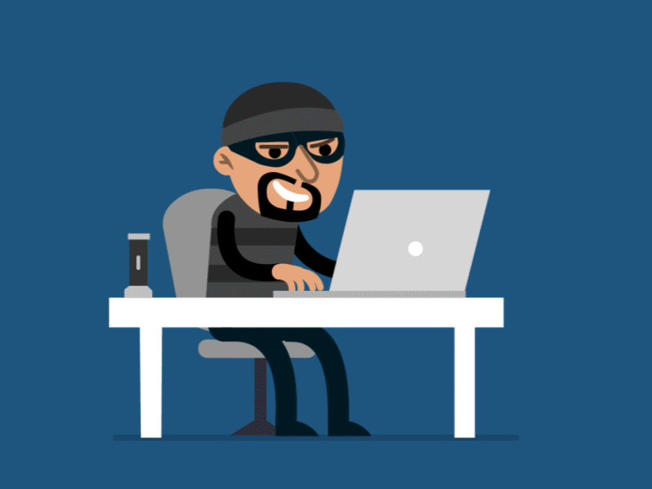
Cyber Security

Slide 18

Call Security!
As well as keeping ourselves protected when using ICT, we need to protect our data from being damaged.
There are many different data threats:
  Unauthorised users, or hackers, can gain access to data by illegal means.
  Viruses can attack and seriously damage files.
  System crashes which affect the hard drive may damage key sections of data.
  Data can be lost accidentally or deleted by mistake.
  Data can also be sabotaged by former employees who are guilty of committing malicious acts.

Slide 19
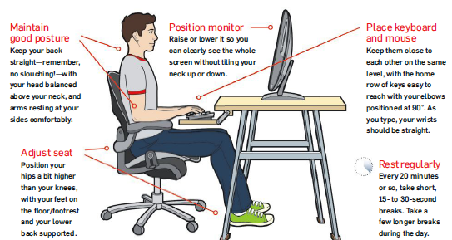
Good use of equipment to avoid ICT related injury

Slide 20

Worksheet: Every Problem has a Solution
Using your notes, complete the
‘Every Problem has a Solution’
Worksheet.

Slide 21

Keeping Data Safe
Answer these questions on a Microsoft Word document called ‘Keeping Data Safe’ by offering a solution to these problems:
Saved files cannot be found
Computer is damaged
File has a virus
Forgotten the file name
Password goes missing/forgotten

Slide 22

Research Task
In a creative way, state 8 employer regulations that they must follow to keep their employees safe from ICT related injury.
  Use Colour
  Use appropriate fonts
  Images/diagrams
  Styling (including borders/page colour/etc)
  https://www.bbc.co.uk/bitesize/guides/z7t6jhv/revision/1

Slide 23

Worksheet: Word Search
Complete the word search worksheet.
Use a different colour for each word!

Slide 24

Homework - Situation
Complete the worksheet ‘Situations’ and decide what is the best course of action for each set of circumstances.
Then complete the research task at the bottom of the sheet.

